Slide 1
Things to Know about the UC Open Access Policy

Slide 2
1. The Policy was adopted by the Academic Council on behalf of UC faculty
Covered:
Not covered:
Senate faculty
“Scholarly articles,” including materials published in journals, conference proceedings, etc.
Articles with a publication agreement signed after July 24, 2013
Students
Adjuncts/Visiting profs
Post-docs and researchers
Books
Popular, non-scholarly articles
Fiction and poetry
Lecture notes
Articles published before the policy was passed
Notes:
-Adopted by faculty, for faculty, not externally imposed.
-As a Senate policy, only covers Senate faculty.
-Only covers recent articles, not those from before it was adopted.

Slide 3
2. Goal: increased access to the research and scholarship of UC
Notes:
Increased access is the main goal.
-No dark archiving required for articles where the policy’s license is waived.
-No local copy for articles available in an OA journal or another OA repository.
-Benefits: public good, increased awareness of UC scholarly output, more readers and citation for UC work.

Slide 4
3. You do not need to change your publishing practices
CC-BY xlibber: https://www.flickr.com/photos/xlibber/4855182596/sizes/l
Notes:
-Faculty do not need to change where they’re publishing. They don’t need to publish in OA journals.
-They don’t need to negotiate different terms in their author agreements. Faculty can rely on the policy for broad rights to share their work, regardless of a publisher’s default terms, as long as they haven’t gotten a waiver.

Slide 5
4. It costs no money to comply with the policy
Notes:
-Making an article open access *at the journal website* sometimes costs money, depending on the journal.
-This policy is about making a version of each article freely available separately from the version of record – in eScholarship, UC’s open access repository.
-Publishers know about this. About 200 were notified over a year ago, and only a few have been requesting waivers.

Slide 6
5. We’ve got resources to help faculty make informed decisions
?
Notes:
-Decision tree on the FAQ page to help faculty understand what to do, at a glance.
-OSC site also has FAQs, information on publishers contacted and waivers requested, deposit quick start guides, and more.
-Always looking for new ways to better convey OA Policy information – e-mail us with ideas for new resources to add.

Slide 7
6. There are two phases of the Policy implementation across UC
Notes:
-UCI, UCLA, and UCSF have served as pilot campuses while we build support for participation.
-Resources about the policy will show slightly different guidance, depending by campus, until everyone is in the second phase.

Slide 8
7. Faculty deposit is now required at non-pilot campuses* (as of Nov. 1, 2014)
Notes:
*Feel free to revise with your campus name!
-Manual deposit has been streamlined: single screen, drag-and-drop upload, auto-fill of some fields once a DOI is provided.
-Pilot campuses started last fall; remaining seven should be depositing now.
-Still requires faculty to know about the policy and initiate the process.

Slide 9
8. Faculty deposit will look very different at non-pilot campuses* in September 2015
Notes:
*Feel free to revise with your campus name!
Publication management system
-Instead of relying on faculty to initiate, it will email them when it finds articles in academic databases that appear to match their profile information, asking them to confirm and provide a copy.
-Single sign on (shibboleth).
-Pilot campuses have access now, everyone else by next fall.
-Proxies can be delegated to upload and manage articles on faculty authors’ behalf.

Slide 10
9. Deposited articles will be displayed in eScholarship, UC’s IR
Notes:
Regardless of deposit route (manual or prompted by email), regardless of whether faculty provide full text or an open access link, every article ends up with a record in eScholarship.
-Growing all the time, from all over the world, with traffic coming from web searches, Google Scholar, etc.
-60% of visitors are non-US.
-Provides viewing and download statistics for authors.

Slide 11
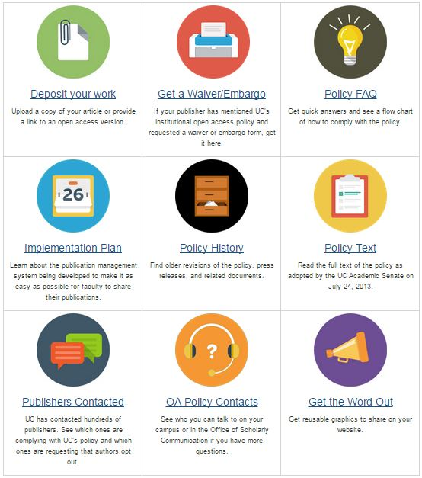
10. The Office of Scholarly Communication site is your friend
uc-oa.info
Notes:
Where to find:
-decision tree, FAQ
-deposit quick start guides and deposit starting point
-list of contacted publishers and waiver data
-waiver and embargo generator
-osc@ucop.edu email address, for help with tricky questions

