Slide 1
UC’s Open Access Policies:
Scope, comparisons, support for deposit

Slide 2
The University of California open access policies now cover more authors than any other institutional OA policy in the world.
Notes:
This has probably been true since 2013, because we have a lot of faculty across 10 campuses. But the difference is even bigger now.

Slide 3
Divider Slide
Who?
October 2015
July 2013
All Non-Senate UC employees
May 2012
All Senate Faculty
UCSF
Senate OA Policies
Presidential OA Policy

Slide 4
What? “scholarly articles”
Not:
-books
-dissertations
-software
Senate OA Policies
Presidential OA Policy
Notes:
Term not defined in the senate policy. There’s some flexibility for things like conference proceedings and book chapters, to account for different author and disciplinary views about what should be considered a “scholarly article.”
Presidential policy definition: Scholarly Articles: Published research articles in the broadest sense of the term. A narrower term could have the effect of excluding works published in a certain format, discipline or practice. For example, the term “scholarly journal articles” might exclude those who publish in edited volumes; the term “peer-reviewed scholarly articles” might exclude law reviews which are reviewed by students or by editorial collectives.

Slide 5
Articles are covered when…
the publication agreement was signed after the policy was issued.
Systemwide Senate: July 24, 2013
UCSF Senate: May 21, 2012
Non-Senate employees:
October 23, 2015
Senate OA Policies
Presidential OA Policy

Slide 6
How? policy creation
Written by Senate
Reviewed by Senate
Adopted by Senate, for its members
Written by Task Force
Systemwide open review
Issued by President, covers all employees
Senate OA Policies
Presidential OA Policy

Slide 7
How? same journals, no new $
Senate OA Policies
Presidential OA Policy
Notes:
It DOESN’T say where to publish, and it doesn’t require the paying of APCs.

Slide 8
How? same journals, no new $
Open Access
Author archived
Institutional repositories
Subject repositories
Publisher hosted
OA journals
Hybrid journals

Slide 9
How? same journals, no new $
Open Access
Author archived
Institutional repositories
Subject repositories
Publisher hosted
OA journals
Hybrid journals
Senate OA Policies
Presidential OA Policy
Notes:
Green OA – many publishers have always allowed this.
But not all.

Slide 10
How? policy mechanism
Non-exclusive copyright license to UC, rights retained by UC when author signs publication agreement.
Senate OA Policies
Presidential OA Policy (if authors own copyright)
Notes:
(only for Presidential Policy authors who own copyright)

Slide 11
How? policy mechanism
For some authors, UC is the copyright owner under the university’s copyright ownership policy.
Presidential OA Policy
(if authors do not own copyright)

Slide 12
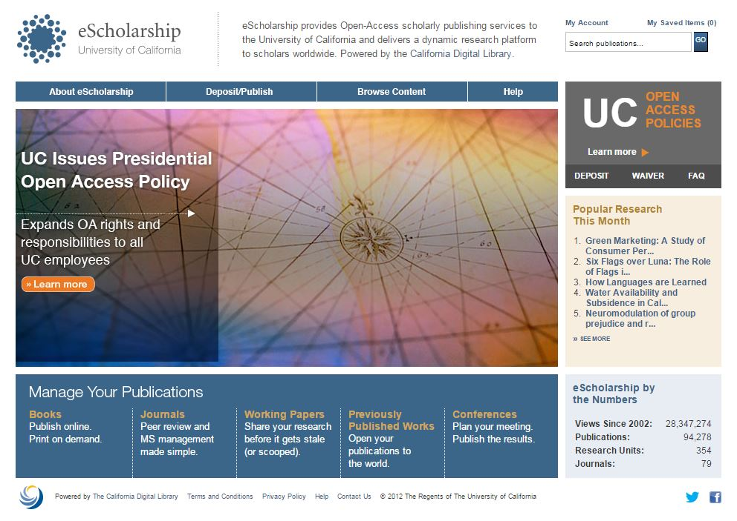
Where? eScholarship
Senate OA Policies
Presidential OA Policy
Notes:
Modern, mobile-friendly front end redesign coming in 2016.

Slide 13
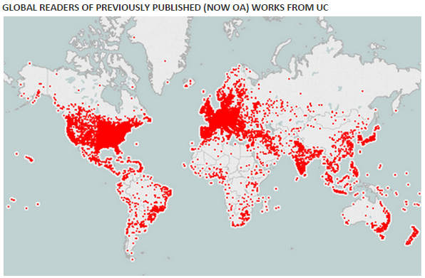
Where? worldwide
Senate OA Policies
Presidential OA Policy
(not included in data shown)
Notes:
This map reflects traffic to articles deposited under the Senate policy. Articles covered under the Presidential OA Policy will join soon join them.

Slide 14
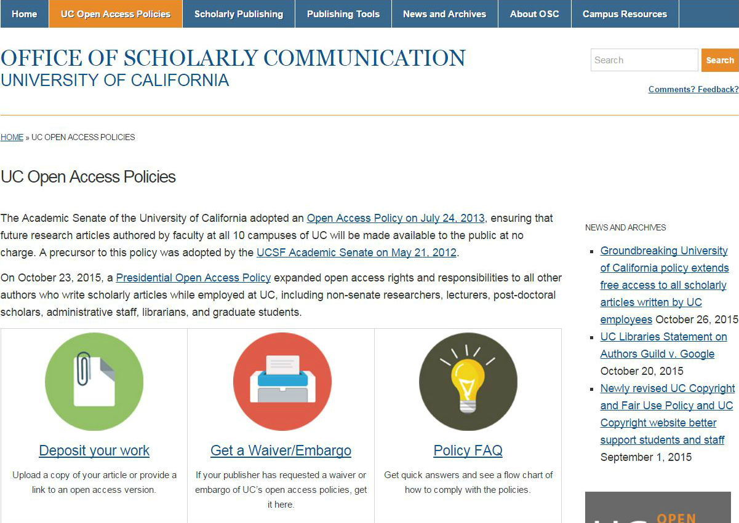
See uc-oa.info
for definitions and details
Notes:
Most people know whether they’re a UC employee and whether or not they’re Senate faculty. For those who don’t, there is more detailed information at uc-oa.info/policy-faq/

Slide 15
Publishers: communication
Over 200 publishers contacted in 2013.
Publishers showing support include SAGE, Springer, and Wiley.
For more information see uc-oa.info/publisher-communications/
Senate OA Policies
Presidential OA Policy
Notes:
Lots of publishers have good green OA policies.

Slide 16
Publishers: waivers
A waiver opts out of a UC open access policy license for a particular article. The author’s rights are limited to what is allowed by the publication agreement signed with the publisher.
Senate OA Policies
Presidential OA Policy

Slide 17
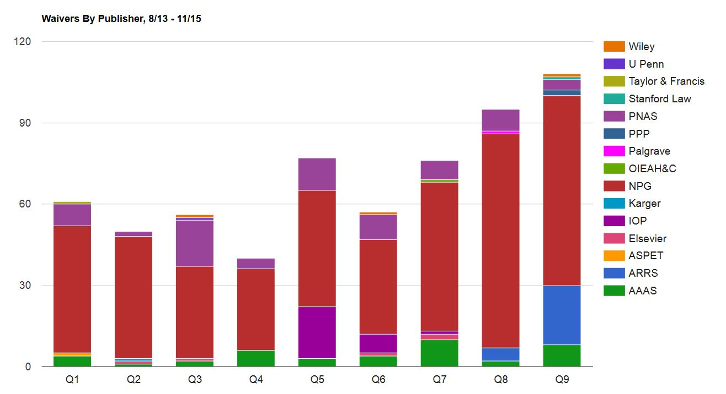
91% of waiver requirements come from 3 publishers.
74% of waiver requests come from faculty at UCSF
Notes:
Waivers are relatively rare. There were 267 waiver requests in the first 9 months of 2015, compared with 6,173 deposits over the same period.
In first 2 years of systemwide Senate policy, 72% of waiver requests are for Nature journals alone. 91% are from 3 publishers who appear most frequently in the statistics at uc-oa.info/publisher-communications/ : Nature, PNAS, AAAS.

Slide 18
Publishers: waivers
Senate faculty may obtain a waiver for any article they choose under the terms of the Academic Senate policies. Waivers are created at uc-oa.info/waiver-embargo-addendum/
Senate OA Policies

Slide 19
Publishers: waivers
Non-senate employees who hold copyright in their articles may obtain a waiver for any article they choose under the terms of the Presidential OA Policy.
Presidential OA Policy

Slide 20
Publishers: waivers
Non-senate employees who do not hold copyright in their articles must show “compelling circumstances” to opt out.
For more information see uc-oa.info/policy-faq/#waiversembargoes
Presidential OA Policy
Notes:
Remember: waiver requests are rare.

Slide 21
Publishers: waivers
Authors who get a waiver of the policy’s license are still expected to deposit a copy of their article.
UCSF Senate OA Policy
Presidential OA Policy
Notes:
Remember: waiver requests are rare.

Slide 22
UC’s OA policies in a nutshell
 | UCSF Senate | Systemwide Senate | Presidential
Effective date | May 21, 2012 | July 24, 2013 | October 23, 2015
What | Scholarly articles | Scholarly articles | Scholarly articles
Who | UCSF Senate faculty | All Senate faculty | Non-Senate UC employees
“Compelling circumstances” for waivers? | No | No | Yes, IF author does not own copyright in article
Deposit (not for public view) required even with waiver? | Yes | No | Yes

Slide 23
Publication management system for Senate faculty (and eventually all employees)
1. Click the link in the notification email and log in using your existing UC campus credentials.
Screen capture courtesy of Symplectic.
Used with permission. All rights reserved.
Notes:
Senate faculty at all ten campuses are able to log in. Most campuses have activated the system’s personalized emails.
Adding non-Senate employees to the system will take more time.

Slide 24
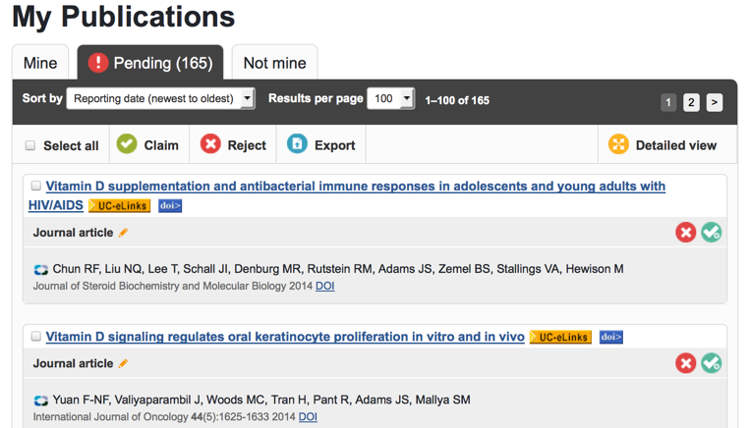
Publication management system
2. You’ll be presented with a list of your recent publications. Use the checkmark icon to claim those you’ve authored, or the X icon to reject any that aren’t yours.
Screen capture courtesy of Symplectic.
Used with permission. All rights reserved.

Slide 25
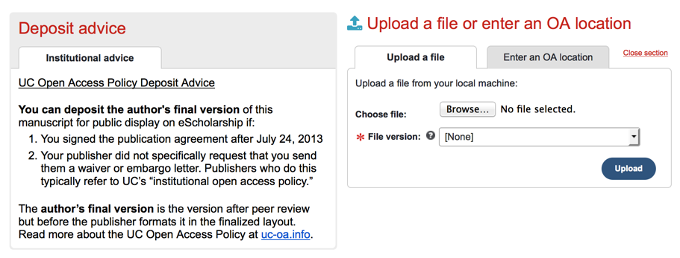
Publication management system
3. If you claim an item that’s covered by the UC Open Access Policy, you’ll be prompted to upload a file or provide a link (if the article is already openly available).
Screen capture courtesy of Symplectic.
Used with permission. All rights reserved.

Slide 26
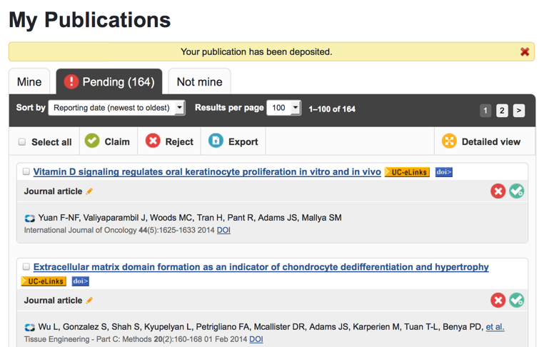
Publication management system
4. Once your deposit is complete, you’ll be returned to your list of recent publications, in case you need to verify others. You will receive additional email notifications when we discover new publications authored by you.
Screen capture courtesy of Symplectic.
Used with permission. All rights reserved.

Slide 27
Publication management system: User feedback
Notes:
56% have rated the experience as somewhat or much easier than expected, while 32% have indicated that the deposit experience was “about what they expected.”

Slide 28
Publication management system: User feedback
Notes:
92% of respondents have indicated that they were either very or somewhat likely to use the system to deposit another publication in the future.

Slide 29
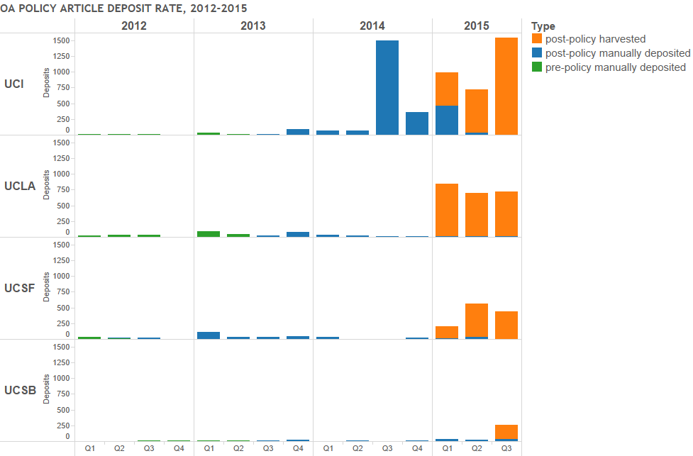
Easier deposit = more articles
Notes:
Activation of publication management system for Senate faculty has led to dramatic increases in deposits so far.

Slide 30
Looking ahead: expanding the system
Publication management system now live for Senate faculty at all 10 campuses.
Addition of non-Senate employees to follow in 16/17.
Senate OA Policies
Presidential OA Policy

Slide 31
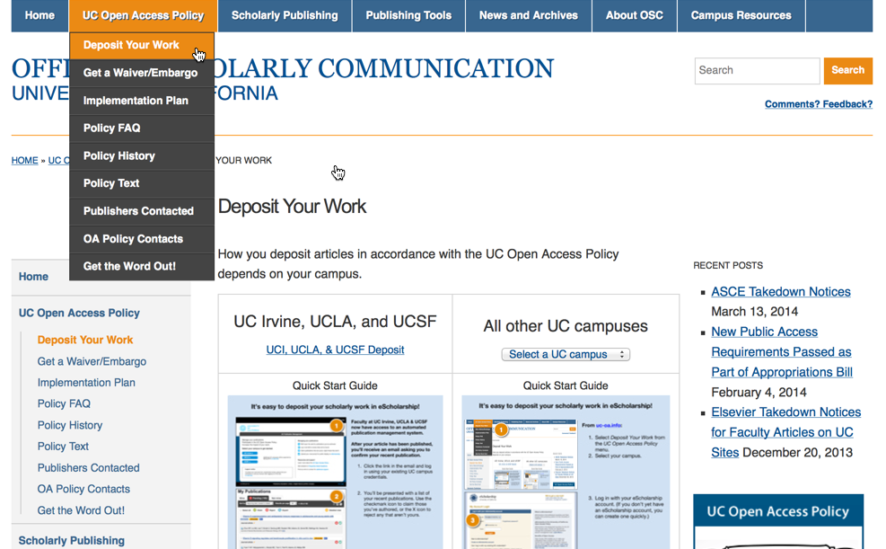
Non-senate employees: manual deposit
1. Select Deposit Your Work from the UC Open Access Policy menu at uc-oa.info.
2. Select your campus.
Presidential OA Policy
Notes:
For non-Senate employees

Slide 32
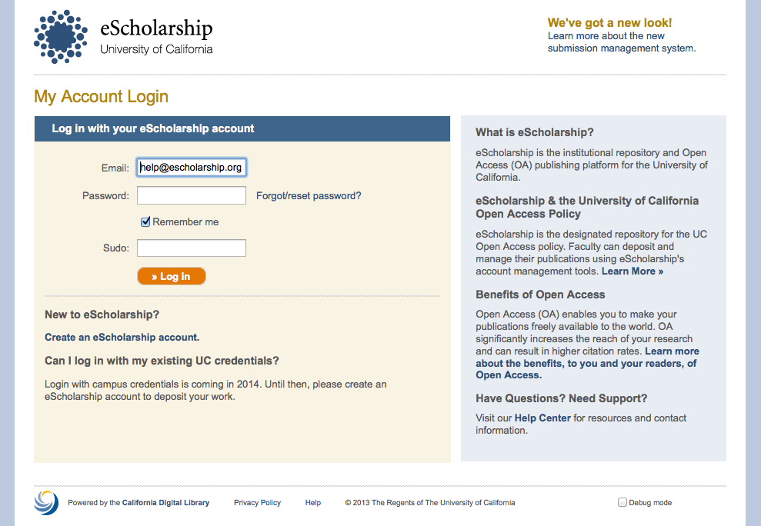
Non-senate employees: manual deposit
3. Log in to your eScholarship account.
Presidential OA Policy

Slide 33
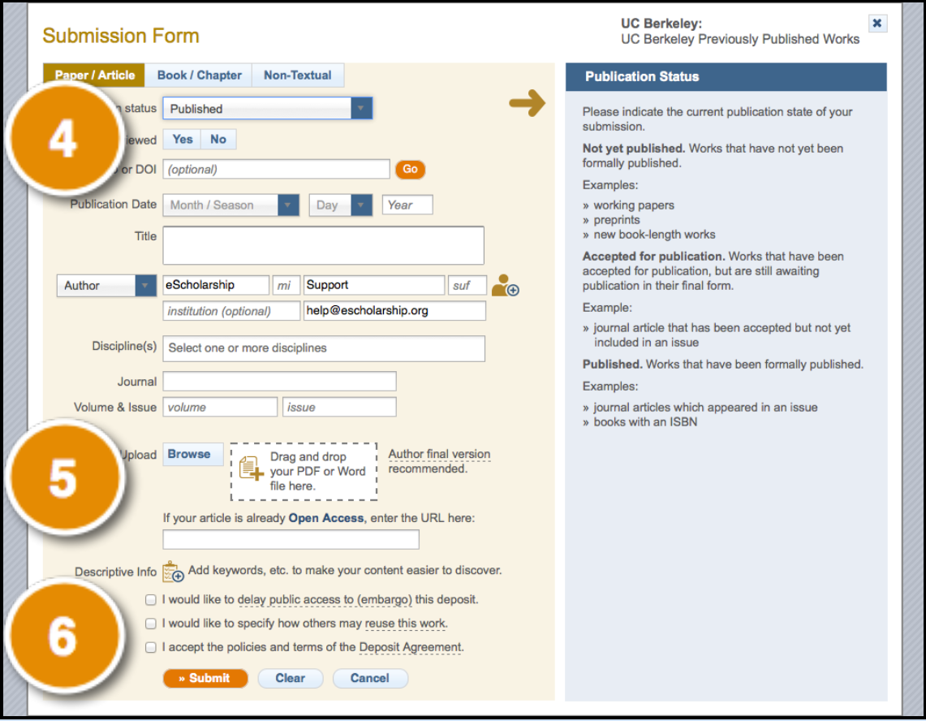
Non-senate employees: manual deposit
4. Enter a few details about your work. (Tip: Entering a DOI or PubMed ID will automatically complete the form for you!)
5. Provide a file. You can upload your manuscript or, if your manuscript is already openly available, provide a link.
6. Specify how others may reuse your work, acknowledge the deposit agreement, then click Submit.
More information at uc-oa.info
Presidential OA Policy

Slide 34
Join the conversation
Visit the Office of Scholarly Communication website for:
Policy text
Answers to FAQs
Outreach resources
Campus contacts
uc-oa.info

Slide 35
Questions?

Slide 36
Common question: definition of employees
Employees: All faculty, academic appointees (includes academic administrative officers, Cooperative Extension and University Extension appointees, librarians, residents, interns, and postdoctoral scholars), students who are employed by UC, staff, and administrators who are paid a salary, stipend, or hourly rate, excluding those holding “Without Salary” appointments, volunteers, and recalls.

Slide 37
Common question: senate faculty
Academic Senate Title; Covered by Senate Open Access Policy
Professorial - Tenure | Senate
Professorial - Non Tenure | Senate
Professorial - Recall | Senate
Professorial - Emeritus* | Senate
Clinical Professor of Dentistry - 50% or More - Tenure
Clinical Professor of Dentistry - 50% or More - Non Tenure
Supervisor of Physical Education - Tenure
Supervisor of Physical Education - Non Tenure
Supervisor of Physical Education - Recall
Acting Professor - Senate | Senate
Acting Professor - Non Senate
Lecturer with Security of Employment | Senate
Lecturer w/Potential Security of Employment-100%-Senate | Senate
Lecturer with Security of Employment - Recall | Senate
Lecturer with Security of Employment - Emeritus* * | Senate
Lecturer with Potential Security of Employment
Lecturer
Professor in Residence | Senate
__________ - Senate - Emeritus* | Senate
Professor of Clinical ________ | Senate
Visiting Professor
Adjunct Professor
Health Sciences Clinical Professor
Clinical Professor - Volunteer (not faculty per APM 110)

Slide 38
We welcome reuse and adaptation!
The screenshots on slides 23-26 are used with permission of Symplectic. Please do not alter them or make your own.
The photographs (slides 1, 2, 4, 45) are © 2015 University of California, available for noncommercial use under the terms of the UC digital image repository. See http://ucop.webdamdb.com/pages.php?pageId=8377.
The parts we created, including the text, tables, and PowerPoint drawings, are provided by the University of California under a Creative Commons Attribution 4.0 International License.
Screenshots from the OSC site include licensed icons; contact OSC if you want to use them in a different context.

